Slide 1
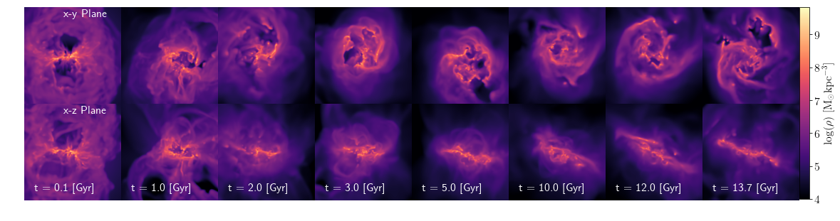
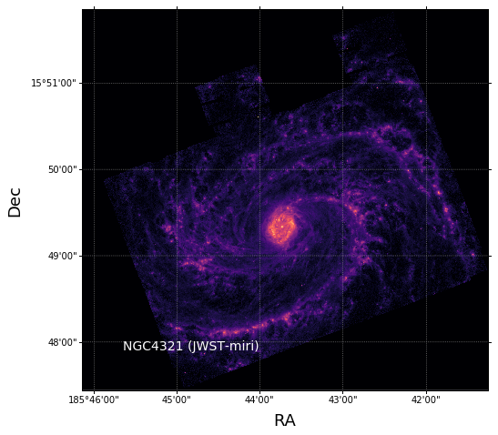
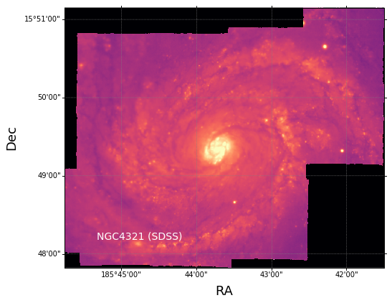
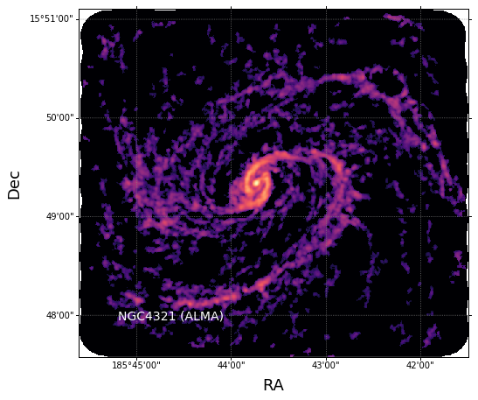
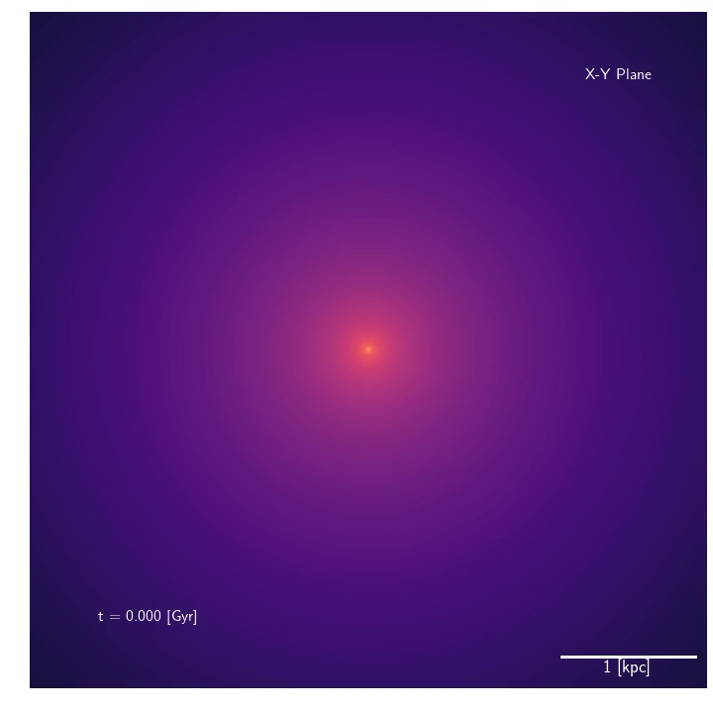
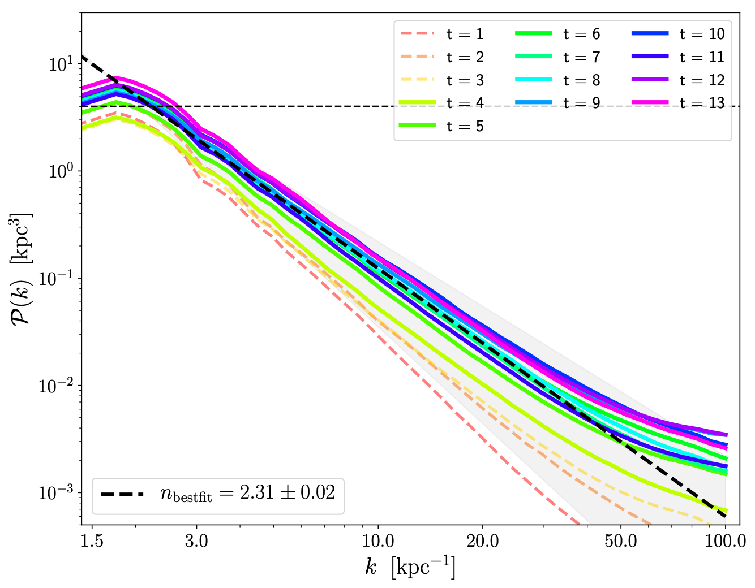
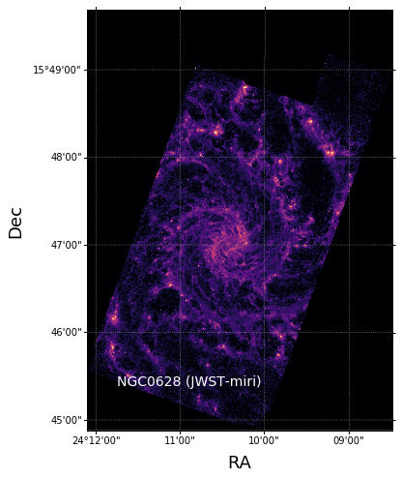
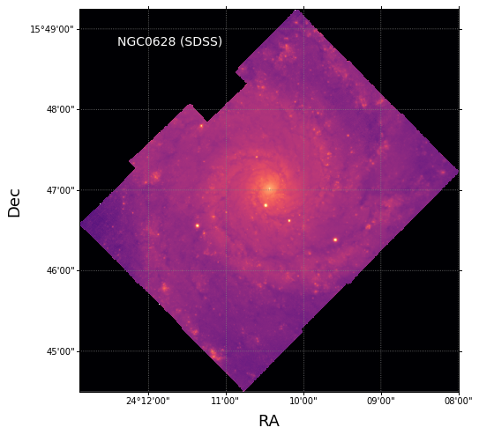
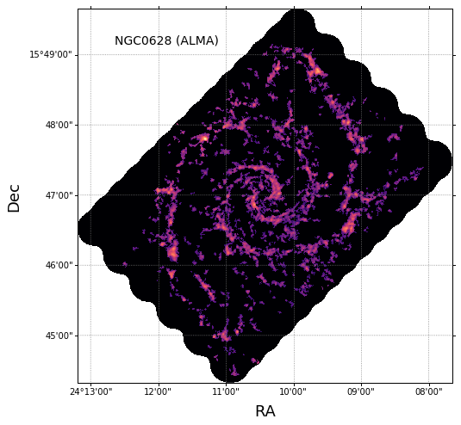
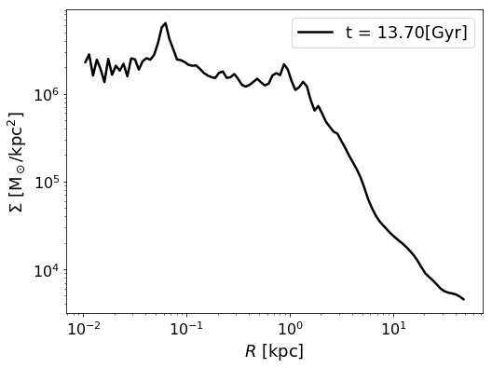
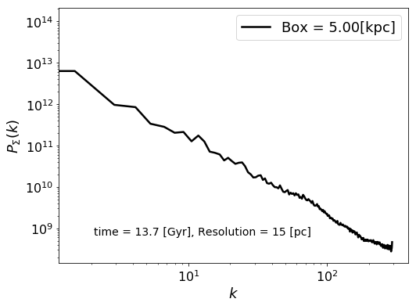
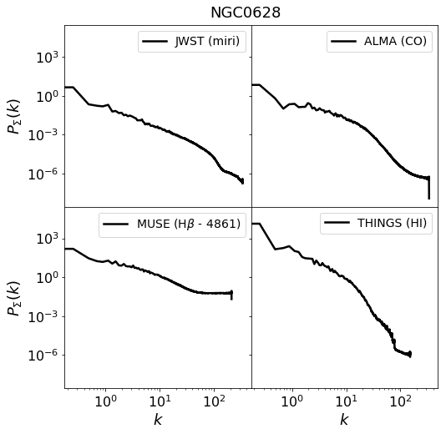
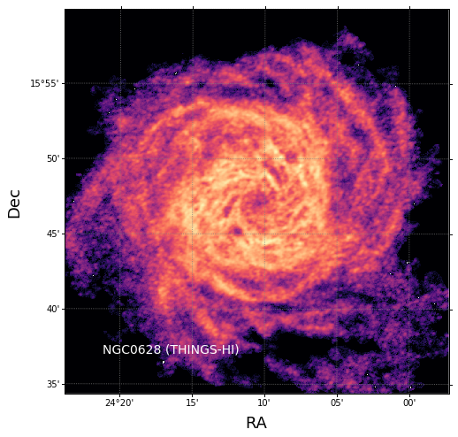
Power Spectra of Turbulent Galactic Gas
Galactic Simulations
[Task 1]
Observations
[Task 3]
(arXiv:2209.08631, arXiv:1603.00526)
— NGC4321
(PHANGS TEAM)
— NGC0628
$$P∝k^{n}$$
Power Spectrum
[Task 2]
[Task 4]

Slide 2
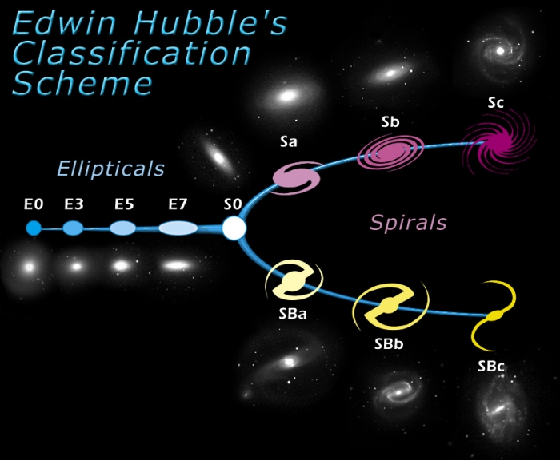
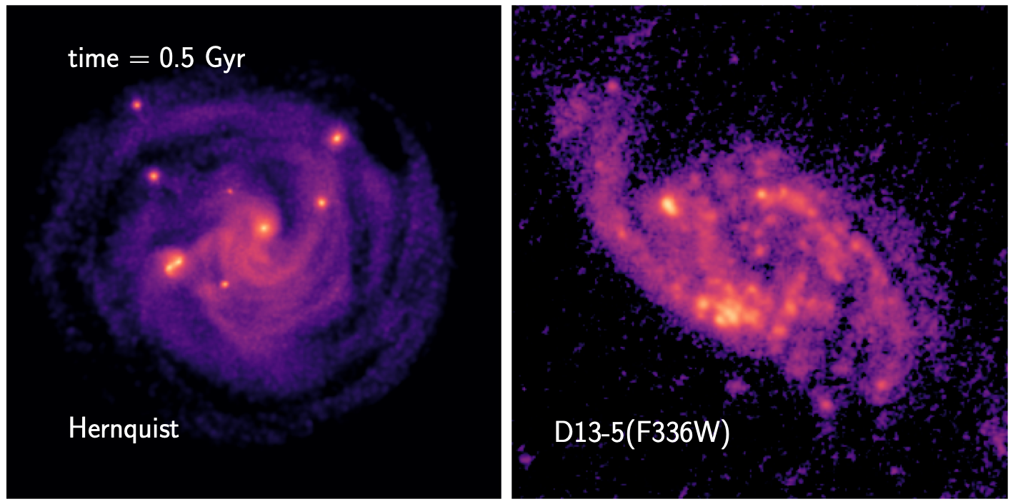
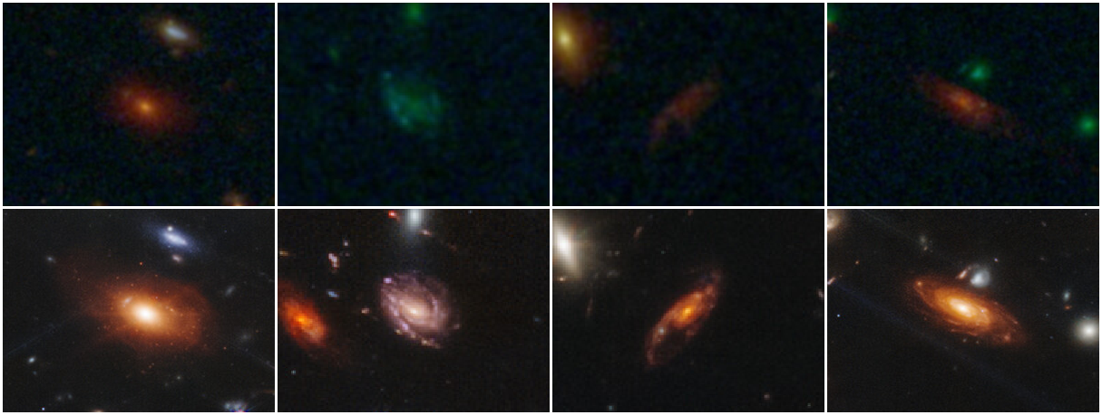
Clumpy Galaxy
arXiv:2312.05316
High-Redshit Galaxies
HST
(SMACS 0723 field)
JWST
Source: https://aasnova.org/2022/11/01/jwst-takes-a-peek-at-the-first-ever-galaxies/

